Slide 1

K-Mismatch Problem: Simple Library for Complex Problem
Project Number: 24-1-D-13
Supervisor: Dr. Zakharia Frenkel
Presenters: Vladimir Brustinov, Nik Lerman
Notes:
Good afternoon, everyone.
We are excited to present our capstone project on the K-Mismatch Problem and our journey towards its optimal implementation.
I am Vladimir Brustinov, and with me is Nik Lerman.
Let's dive into the details of our work.

Slide 2
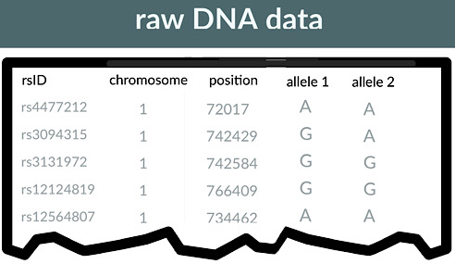
Background and Problem Statement
The increasing complexity of string matching in computational biology, cybersecurity, and text processing highlights the necessity for more efficient algorithms adept at managing mismatches effectively.
K-mismatch search is still available problem in these directions.
The main challenge of the problem is to reach high search speed with less computer power requirements.
Notes:
String matching is crucial in various fields such as computational biology, cybersecurity, and text processing.
As string matching becomes more complex, efficient algorithms are needed to handle mismatches effectively.
Traditional algorithms often struggle with the complexity and efficiency required for real-world applications, especially when mismatches are involved.
The K-Mismatch Problem addresses this by allowing a specified number of mismatches, making the search more flexible and applicable.
Our main challenge is to achieve high search speeds while minimizing computational power requirements.

Slide 3
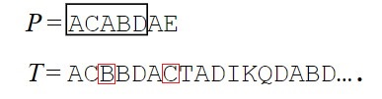
K-Mismatch problem
Input:
A text string T of length n.
A pattern string P.
An integer k - maximum number of allowed mismatches.
Output:
A list of all positions in the text T where the pattern P occurs with at most k mismatches.
Notes:
Let's define the problem:
Input: A text string T of length n, a pattern string P, and an integer k representing the maximum allowed mismatches.
Output: A list of all positions in the text T where the pattern P occurs with at most k mismatches.
Example from picture
This problem is significant because it generalizes the exact string matching to more practical scenarios where slight errors or variations are acceptable.

Slide 4
System Requirements
Implement K-Mismatch algorithm with performance improvements
Utilize advanced C++ features for enhanced efficiency and maintainability
Develop a system suitable for integration into larger software systems
Create a standalone tool for various applications
Notes:
Given the background, we set out with clear objectives for our system. Our primary goal was to implement the K-Mismatch algorithm with substantial performance improvements. We aimed to utilize advanced C++ features not just for speed, but also to enhance maintainability - a crucial factor for long-term viability. We designed our system to be both integrable into larger software ecosystems and usable as a standalone tool. This dual-purpose design ensures flexibility for various use cases, from research applications to industrial-scale text processing tasks.

Slide 5
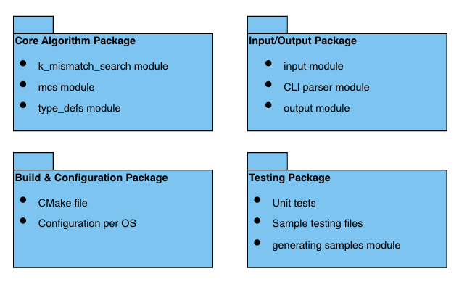
Solution Overview
Core Algorithm module
Input/Output package
Build and Configuration package
Testing package
Notes:
Our solution is a comprehensive C++ library with several key modules. The core of our implementation lies in the k_mismatch_search and mcs (Minimal Coverage Set) modules. The k_mismatch_search module contains the main algorithm logic, optimized for speed and efficiency. The mcs module generates and manages the Minimal Coverage Set, a crucial component for filtering potential matches quickly. Supporting these core modules, we have an Input/Output package for efficient data handling, a Build and Configuration package to ensure cross-platform compatibility, and a robust Testing package for maintaining code quality and performance. This modular architecture allows for easy maintenance and future enhancements.

Slide 6




Technologies and Tools
Development Environment: VS Code with g++14 compiler
Version Control: Git and GitHub
Build System: CMake for cross-platform configuration
C++17 features for optimization
Notes:
To achieve our goals, we leveraged a modern tech stack. We used Visual Studio Code with the g++14 compiler as our primary development environment. This choice gave us access to C++17 features, which were instrumental in our optimization efforts. For version control, we used Git and GitHub, which facilitated collaborative development and code review processes. We employed various Visual Studio Code extensions for profiling, which helped us identify and address performance bottlenecks. A key decision was using CMake as our build system. CMake's cross-platform configuration capabilities were crucial in ensuring our software runs efficiently on both Windows and Linux environments.

Slide 7
Challenges
Cache-Based Optimization
Parallel Processing Overhead
Cross-Platform Compatibility
MCS Generation Efficiency
Huge Sequential Texts Processing
Notes:
One major hurdle was cache-based optimization. We addressed this by implementing a two-level structure optimized for SIMD operations, significantly reducing cache misses. Parallel processing initially introduced overhead, negating gains on smaller inputs. We solved this with an adaptive parallelization strategy, dynamically adjusting based on input size and available hardware. Cross-platform compatibility was ensured through careful abstraction and CMake configurations. The MCS generation efficiency was a significant bottleneck, which we tackled using bit-parallel operations and dynamic programming techniques. Lastly, processing huge sequential texts required strict resource management to maintain speed without degrading system performance. Each of these challenges pushed us to innovate and optimize at multiple levels of the system architecture.

Slide 8
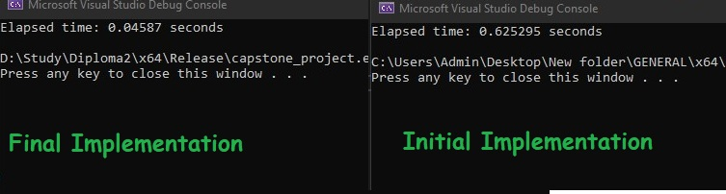
Project Metrics and Achievements
14x speedup in index generation
750,000x speedup in MCS combinations creation
Real time search as close as possible to theoretical predicted improvement naive algorithm
Notes:
Now, let's look at what we achieved. Our optimizations led to significant performance improvements. We achieved a 14x speedup in index generation, which is crucial for quick data retrieval. Most impressively, we saw a 750,000x speedup in MCS combinations creation. This massive improvement in a critical part of the algorithm contributes significantly to the overall performance gain.
[ADD ABOUT THEORETICAL AND ACTUAL GAP]

Slide 9
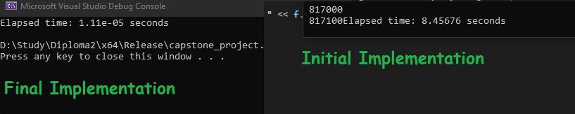
Project Metrics and Achievements
14x speedup in index generation
750,000x speedup in MCS combinations creation
Real time search as close as possible to theoretical predicted improvement naive algorithm
Notes:
Now, let's look at what we achieved. Our optimizations led to significant performance improvements. We achieved a 14x speedup in index generation, which is crucial for quick data retrieval. Most impressively, we saw a 750,000x speedup in MCS combinations creation. This massive improvement in a critical part of the algorithm contributes significantly to the overall performance gain.
[ADD ABOUT THEORETICAL AND ACTUAL GAP]

Slide 10
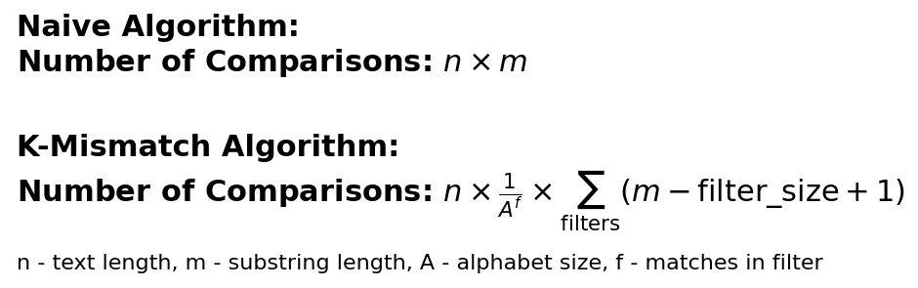
Project Metrics and Achievements
14x speedup in index generation
750,000x speedup in MCS combinations creation
Real time search as close as possible to theoretical predicted improvement naive algorithm
Notes:
Now, let's look at what we achieved. Our optimizations led to significant performance improvements. We achieved a 14x speedup in index generation, which is crucial for quick data retrieval. Most impressively, we saw a 750,000x speedup in MCS combinations creation. This massive improvement in a critical part of the algorithm contributes significantly to the overall performance gain.
[ADD ABOUT THEORETICAL AND ACTUAL GAP]

Slide 11
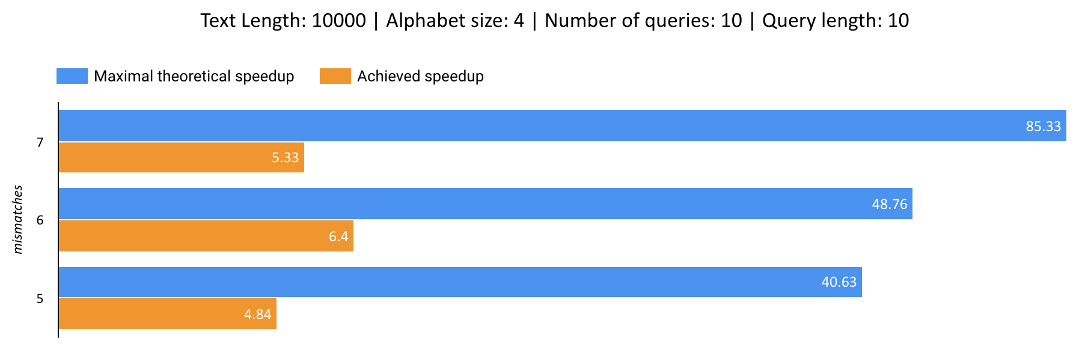
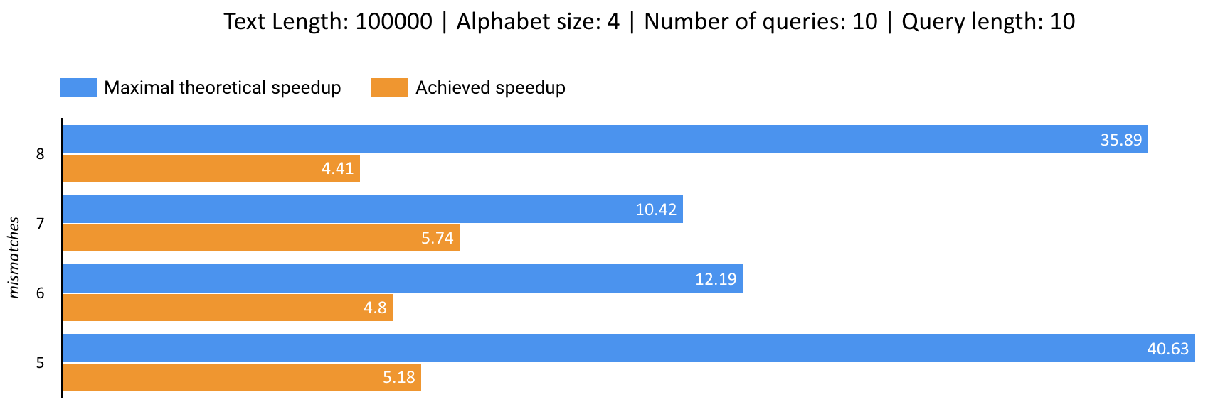
Theoretical & Achieved Speedup
Notes:
Now, let's look at what we achieved. Our optimizations led to significant performance improvements. We achieved a 14x speedup in index generation, which is crucial for quick data retrieval. Most impressively, we saw a 750,000x speedup in MCS combinations creation. This massive improvement in a critical part of the algorithm contributes significantly to the overall performance gain.
[ADD ABOUT THEORETICAL AND ACTUAL GAP]

Slide 12
How to use
Clone the repository:
git clone https://github.com/keepthegoal/24-1-D-13.git
cd 24-1-D-13
Create a build directory and navigate to it:
mkdir build && cd build
Configure and build:
cmake ..
cmake --build . --config Release
Run the program:
./k_mismatch_app -t <text_file> -q <queries_file> -m <num of mismatches>

Slide 13
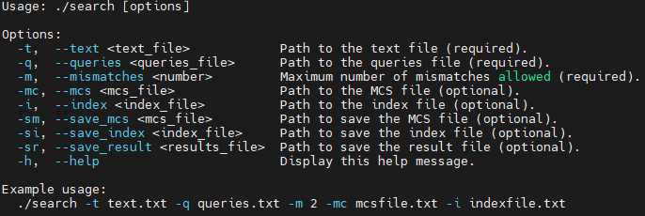
CLI overview

Slide 14
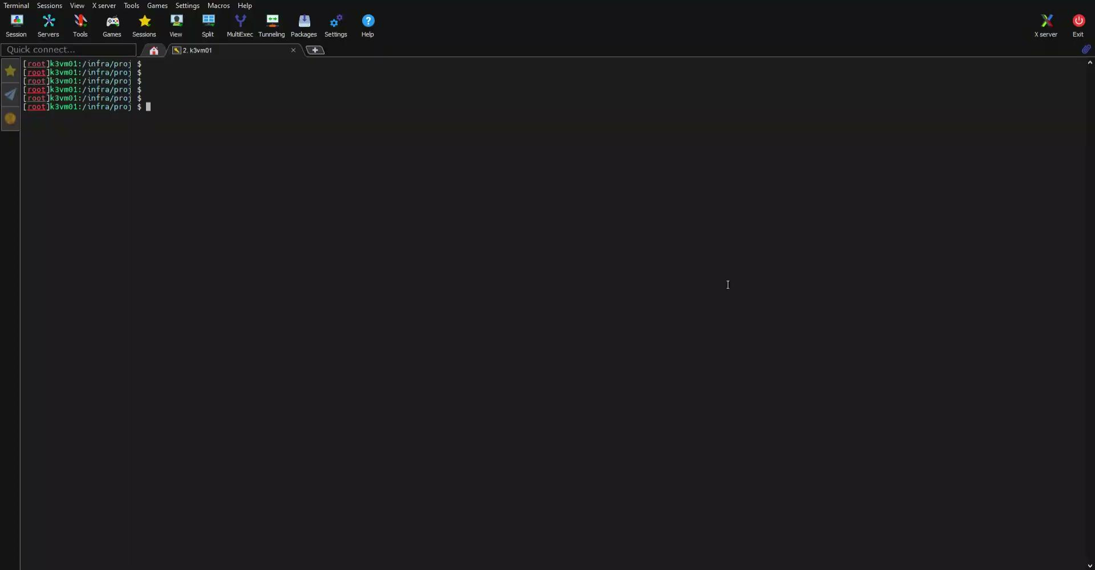
Demo
Notes:
Now, let's see our system in action. This video demonstrates how to use the command-line interface and shows the system's performance on various datasets. Notice how quickly it processes large text files and handles multiple queries efficiently. The command-line interface allows for flexible input of parameters, making it adaptable to different use cases.

Slide 15
Lessons Learned
Balance between algorithmic and low-level optimizations
Importance of cross-platform testing
Value of modular design in optimization
Code readability in performance-critical sections
Continuous learning in optimization techniques
Notes:
This project taught us valuable lessons about optimization strategies. We learned the importance of balancing high-level algorithmic improvements with low-level code optimizations. Cross-platform testing proved crucial, revealing how optimizations can have varying impacts across different environments. Our modular design approach greatly facilitated the optimization process, allowing us to easily benchmark and improve individual components. We also realized the importance of maintaining code readability even in highly optimized sections, crucial for long-term maintenance. Lastly, this project highlighted the value of bridging academic research with industry-focused optimization techniques, inspiring us to seek more such collaborative opportunities in the future.

Slide 16
Conclusions
Recap of main achievements
Potential future improvements
Notes:
To conclude, we've significantly optimized the K-Mismatch algorithm, achieving remarkable speedups across various aspects of the system. Our implementation not only improves performance but also ensures cross-platform compatibility and ease of integration. Looking forward, there's potential for further improvements, particularly in [mention specific areas based on your findings]. We believe this work contributes significantly to the field of string matching algorithms and has practical applications in bioinformatics, cybersecurity, and text processing. Thank you for your attention.

Slide 17
THANK YOU!

Slide 18
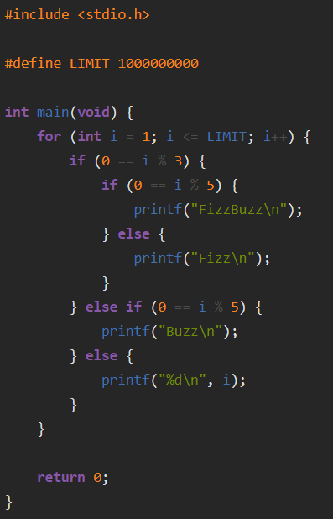
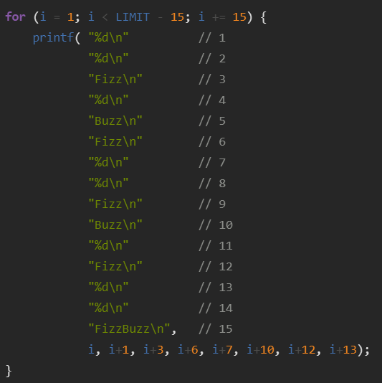
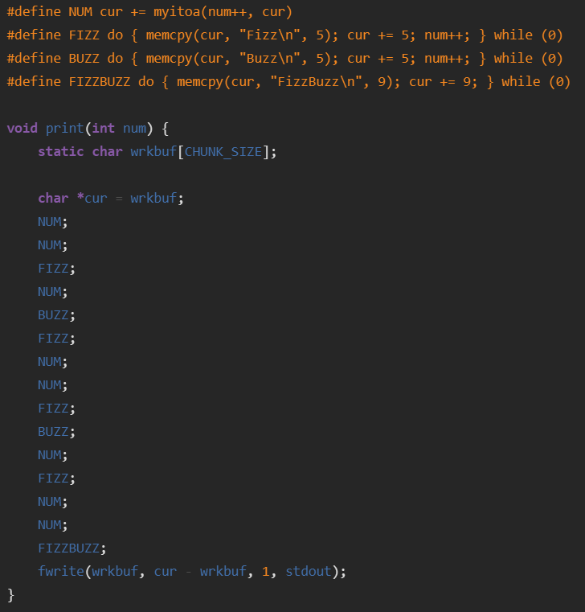
Why?
Before(39.650 s):
After(8.771 s):

